Slide 1
.
Christopher Bauman – www.chrisbauman.com.au

Slide 2
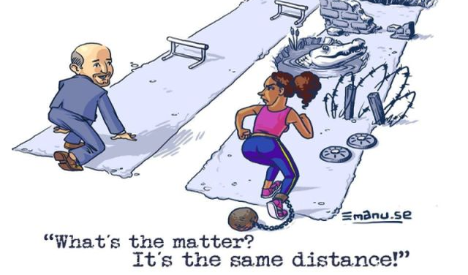
.
Christopher Bauman – www.chrisbauman.com.au

